Slide 1
EDA For Clicking Prediction Advertising
Presented By:
Name : D. Ramamoorthy
Batch : PGDDM34
Course : Data Science And Machine Learning

Slide 2
Chapters
DIntroduction
Objective
Data Overview
Data Sources
Dataset
EDA
Visualization
Conclusion

Slide 3
Introduction
We live in a world where billions of dollars are spent every year on online advertisements. It helps to grow awareness, draw traffic to a website, and encourages the targeted consumers to perform specific actions such as making a purchase.
It is one of the most effective ways to spread marketing and promotional messages and expand the customer base.
Online advertisers use different channels to target audiences, but not all channels perform the same. Depending on various factors this variation in performance is observed

Slide 4
Objective
To display the data in the form of tables
To check the Missing value in the Dataset
To Analyze the Exploratory Data Analysis
To Analyze Visual Exploration of relationship between two variables using different plots.

Slide 5
Data Overview
I will work with the advertising data of a marketing agency to analyze the Explanatory Data Analysis that predicts if a particular user will click on an advertisement.
The consists of 10 Variables: “Age”, “Daily Time Spent on Site”, “Daily Internet Usage”, “Ad Topic Line”, “City”, “Male”, “Country”, “Timestamp”, and “Clicked on Ad”.
dv

Slide 6
Data Source
The data used for the analysis is secondary data collected from the Kaggle website. The data consists of 1009 rows and 10 columns.The dataset consist of below features:
Age : Consumer Age in years
Daily time spend on site : Consumer time on site in minutes
Area Income : Avg.Income of Geographical area of Consumer
Daily internet usage : Avg.Minutes a day Consumer in on the Internet
Ad Topic line : Headline of the advertisement
City : City of consumer
Gender : The Consumer was Male or Female
Country : Country of consumer

Slide 7
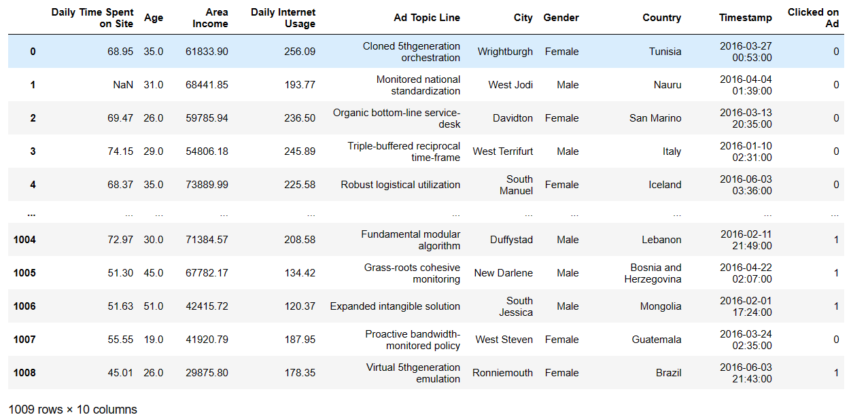
Dataset
dv

Slide 8
Steps in EDA Process
Reading the Data
Understanding the Data/ Getting some Domain knowledge on Data
Replacing Junk Values using NaN values
Converting each and every column to its respective Datatype
Replacing NaN values with some meaningful values
Dropping unwanted columns, duplicated columns and duplicated rows
Saving the pure/cleaned dataset in the desirable format

Slide 9
EDA Using Packages
Exploratory Data Analysis (EDA) is an important step in the data analysis process to understand the structure and characteristics of your dataset. There are several Python packages that are commonly used for EDA. Some of the popular ones include:
Pandas: Pandas is a powerful library for data manipulation and analysis. It provides data structures like Data Frames and Series, which are essential for loading, cleaning, and exploring datasets.
NumPy: NumPy is used for numerical computations. It's particularly helpful for performing mathematical and logical operations on arrays and can be integrated with Pandas for data manipulation.
Matplotlib: Matplotlib is a versatile library for creating a wide range of static, animated, or interactive plots and charts. It's often used to visualize data distributions, trends, and relationships.
Seaborn: Seaborn is built on top of Matplotlib and provides a high-level interface for creating informative and attractive statistical graphics. It simplifies many common data visualization tasks.

Slide 10
Read The Data
Reading data in Python can be done using various libraries and methods depending on the format of the data you're working with. Common data formats include text files, CSV (Comma Separated Values), Excel files, and more. Here are some common ways to read data in Python:
Import pandas as pd
Reading Excel Files: To read data from Excel files, you can use the Pandas library.
pd.read_excel("C:\\Users\\Ramamoorthy\\OneDrive\\Documents\\Data\\advertisement.xlsx")
Reading Csv Files: To read data from Csv files, you can use the Pandas library.
pd.read_csv("C:\\Users\\Ramamoorthy\\OneDrive\\Documents\\Data\\advertisement.csv")
Reading text Files: To read data from text files, you can use the Pandas library.
pd.read_text("C:\\Users\\Ramamoorthy\\OneDrive\\Documents\\Data\\advertisement.text")

Slide 11
Identify Junk Values:
You need to identify the junk values in your dataset. Junk values could be any non-numeric or invalid entries.
Replace Junk Values with NaN:
Use the ‘replace ( ) ‘ method of Pandas to replace the identified junk values with NaN. For instance, if you want to replace all occurrences of a specific junk value, such as “N/A” or “Invalid”, you can do this
data.replace('N/A', np.nan, inplace=True)
data.replace('Invalid', np.nan, inplace=True)
If the junk values are numeric but not valid, you can use numeric values to replace them with NaN. For example:
data.replace(-999, np.nan, inplace=True)
data.replace(99999, np.nan, inplace=True)

Slide 12
Handling Multiple Columns:
You can apply the replacement process to specific columns if needed. For instance, to replace junk values only in the 'Age' and 'Income' columns:
data['Age'].replace('N/A', np.nan, inplace=True)
data['Income'].replace('Invalid', np.nan, inplace=True)
Converting each and every column to its respective Datatype:
You can find the data type of each column in a Pandas Dataframe using the “data.dtypes” attribute.
Replacing NaN values with some meaningful values:
Calculate the mean value for the column where you want to replace NaN values using the
‘mean ( ) ‘ method.
Use the ‘ fillna ( ) ‘method to replace NaN values with the calculated mean.

Slide 13
Apply "bfill" & “ffill” Method:
The "bfill" method use it to fill NaN values backward along the columns.
data.fillna(method='bfill', inplace=True)
The “ffill" method use it to fill NaN values forward along the columns.
data.fillna(method='bfill', inplace=True)
Save the Cleaned Data:
You can save the cleaned Dataframe to a new CSV file if you want to preserve the changes.
data.to_csv('cleaned_data.csv', index=False)

Slide 14
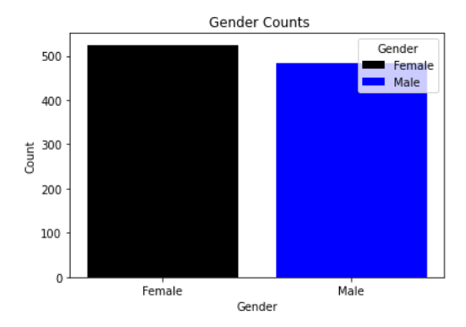
Plots Of Visualization
Some common types of plots and visualizations are:
Bar Chart: A bar chart is used to represent categorical data with rectangular bars. The length of each bar is proportional to the value it represents.
Gender Counts :
Female : 525
Male : 484

Slide 15
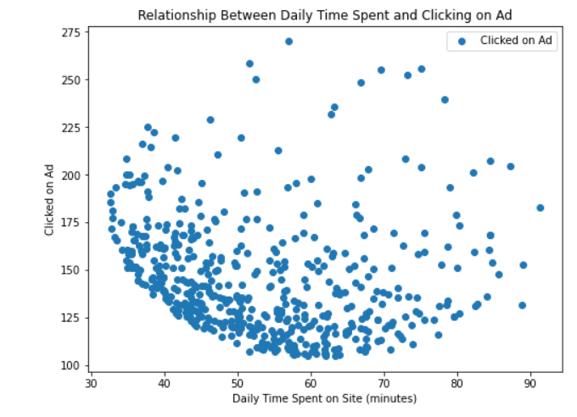
Scatter Plot: Scatter plots are used to display individual data points as dots on a two-dimensional plane. They are useful for showing relationships or correlations between two variables.

Slide 16
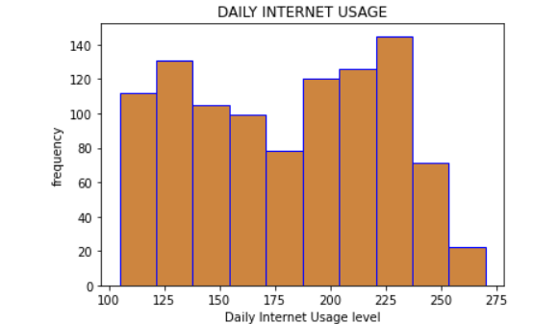
Histogram: A histogram is used to display the distribution of a single variable. It divides data into bins and shows the frequency of data points within each bin.

Slide 17
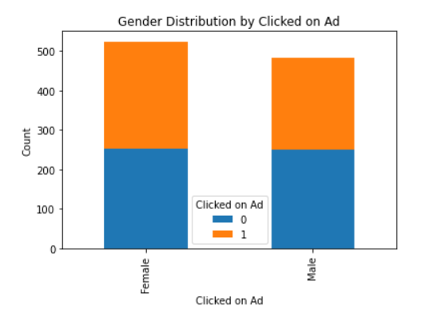
Stacked bar chart : A stacked bar chart is a type of data visualization that is used to display the distribution of a categorical variable, where each category is divided into subcategories, and the subcategories are stacked on top of each other to represent the whole.

Slide 18
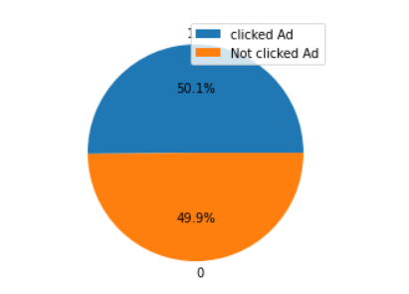
Pie Chart: A pie chart represents data as a circle, with slices (or wedges) representing parts of a whole. It's useful for showing the composition of a data set.

Slide 19
Conclusion
In conclusion, our exploratory data analysis (EDA) for the Click Prediction in Advertising project has provided valuable insights into user behavior and the factors influencing ad click-through rates. Through the examination of key features such as "Daily Time Spent on Site," "Age," "Area Income," "Daily Internet Usage," and others, we have identified patterns and correlations that can help inform our predictive models. By understanding the relationships between these variables, we are better equipped to develop more accurate click prediction models, which can ultimately lead to more effective and targeted advertising campaigns, improving the return on investment for our advertising efforts.

Slide 20


